Slide 1




Tunisian Republic
Ministry of Higher Education and Scientific Research
University of Monastir
Higher Institute of Computer Science of Mahdia(ISIMa)
End of Studies Project
CLASSIFIED ADS WEBSITE
Presented by:
Mr. Hafedh MANCHOUL
Mr. Nader BEN REJEB
Academic supervisor:
Dr. Nizar ELLEUCH
Professional supervisor:
Mr. Kais CHAIEB
Academic Year:
2021-2022

Slide 2
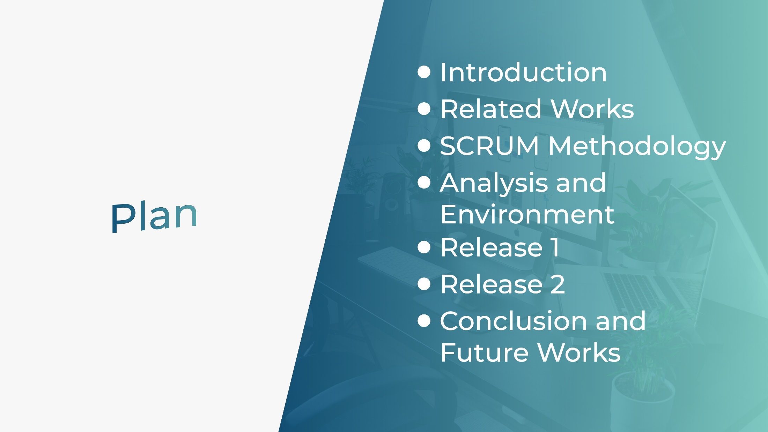
Notes:
During the presentation of our work we will follow this plan, we begin with

Slide 3
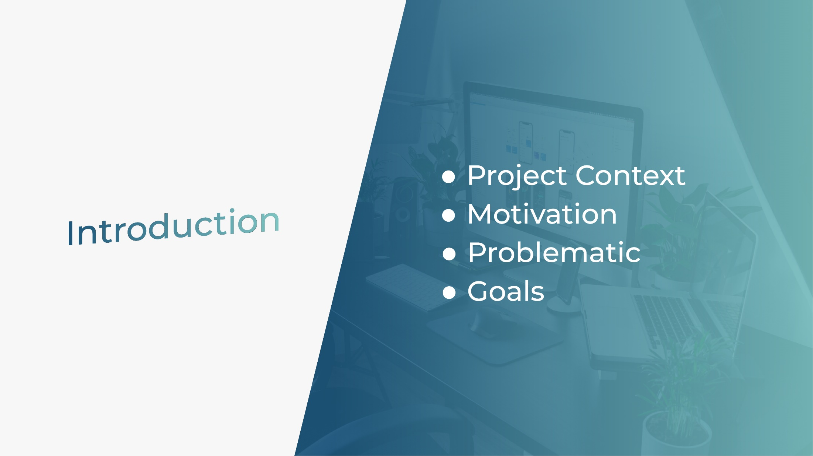
Notes:
The introducion is divided into

Slide 4

PROJECT CONTEXT
-Our project is a classified ads website called “Riwaq” which provides sales and purchases of any type of product
-In this context, we will focus on 2 modules that form our application, namely:
User management
Ads management

Slide 5

MOTIVATION
78%
65%
58%
Of Internet users have made at least one online purchase
made an online purchase on the local market (Tunisian websites & social networks)
Have made an online purchase in the local market in the last 12 months
Notes:
For the motivation we notes that

Slide 6




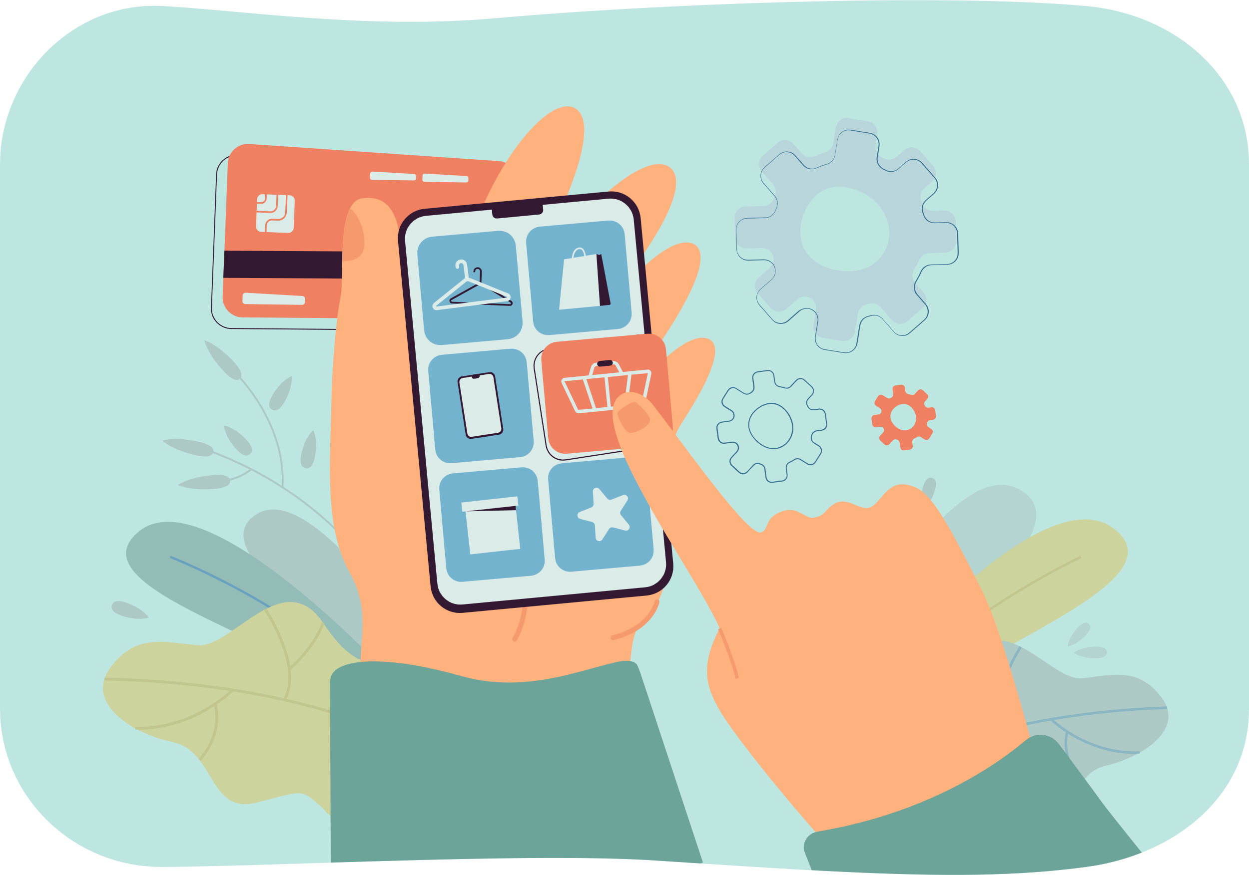

PROBLEMATIC
I want to get an ideal product that meets my requirements
I want to sell my product rapidly
How to acquire an ideal product?
Seller
Buyer
Notes:
For the seller

Slide 7


GOALS
1
Offer all products category
Provide an accurate description of the products
2
3
Practical buy and sell application
Seller
Buyer
Notes:
Our goals are

Slide 8

Notes:
And thos are some related works such as

Slide 9
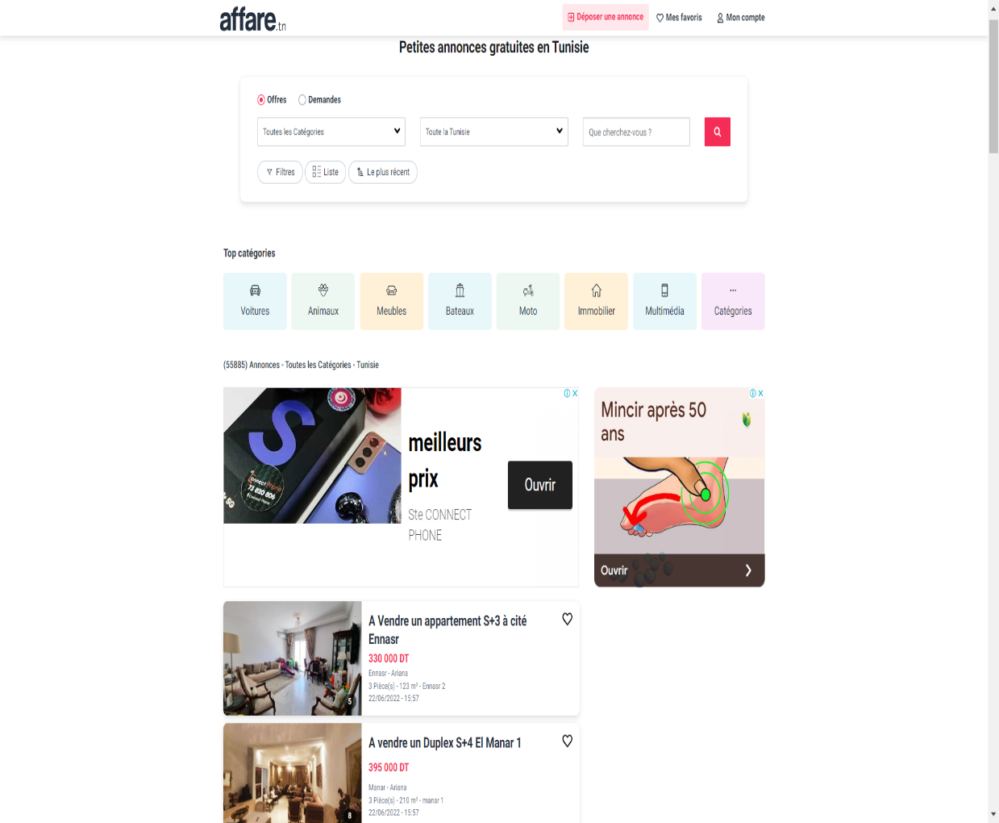
RELATED WORKS
Affare
Affare
-Classified ads website
-Search for offers or requests in many categories
-Ability to communicate between their users
Notes:
is a classified ads website that provide to their users the ability to search for offers or requests in many categories. Affare provide to the registered users the ability to communicate between each other’s.

Slide 10
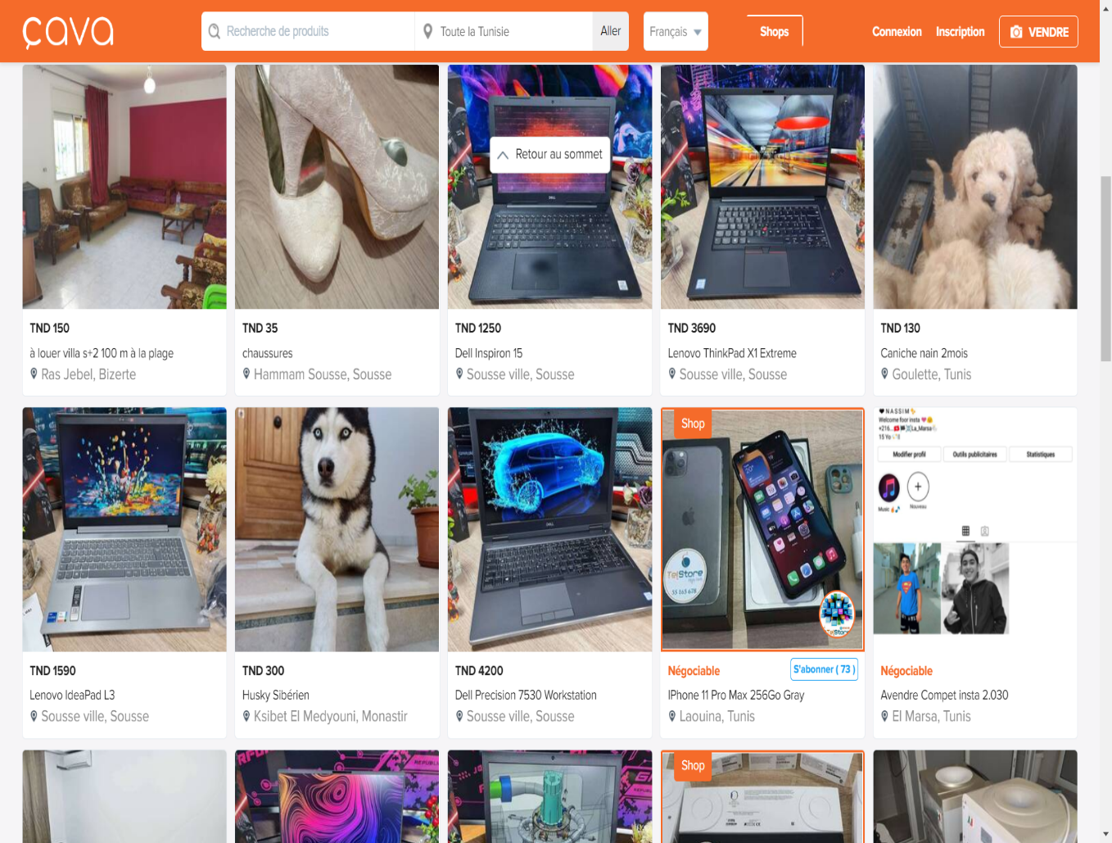
RELATED WORKS
Cava
Cava
-The users can post their products for sale and buy others
- interreact via messages
Notes:
-Classified ads website that give for their users the power to post their products for sale or to buy others. Users in cava.tn can interreact via messages to carry out transactions.

Slide 11
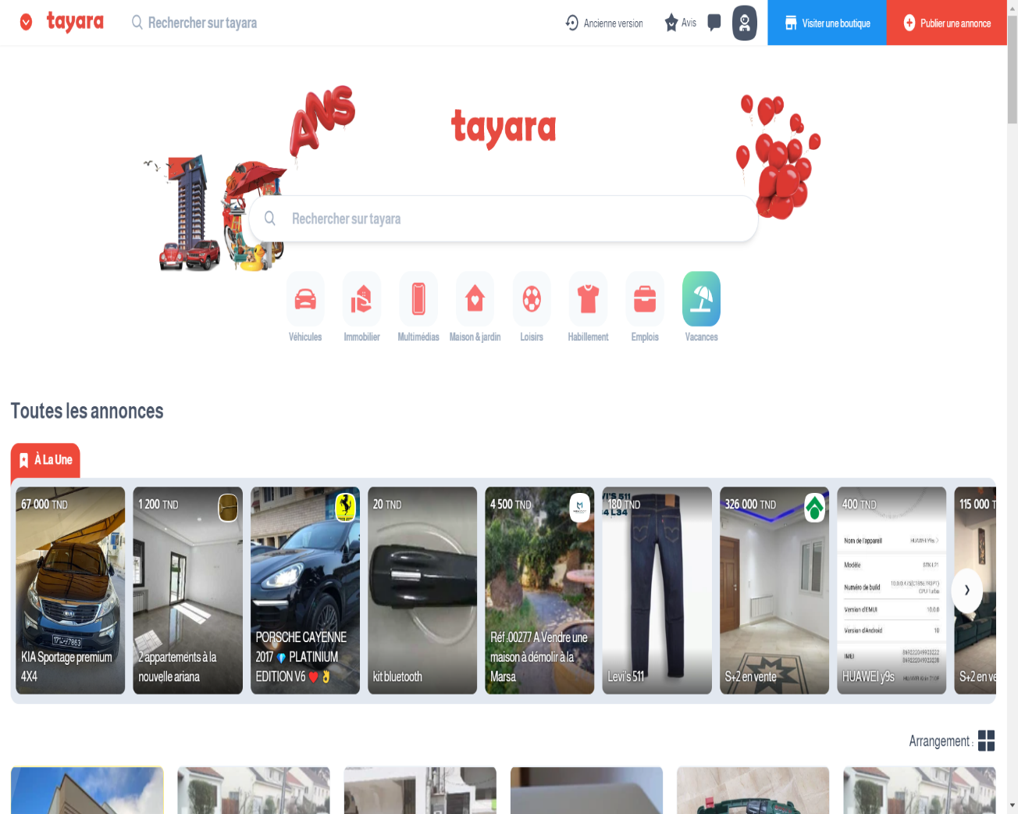
RELATED WORKS
Tayara
Tayara
-post ads with more details
-communicate with buyer and seller
Notes:
The leader of the Tunisian classified ads websites, Tayara provide to their users the ability to post ads in almost all the categories with adding more details about the products, And the ability to communicate between the buyer and the seller via messages.

Slide 12


Slide 13
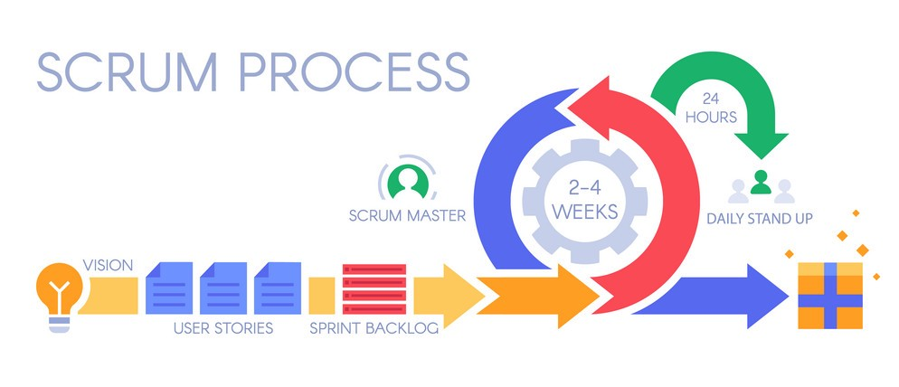
WHAT IS SCRUM
Notes:
Our methodology adobted is Scrum which is is an agile development methodology used in the development of Software based on an iterative and incremental processes

Slide 14

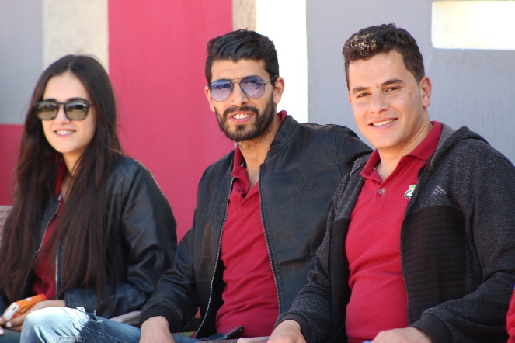

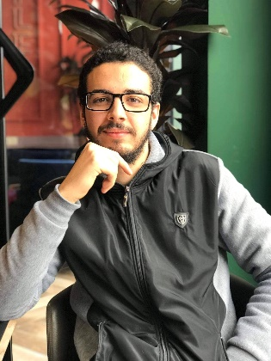
SCRUM TEAM
Project Scrum Team
There are three main roles in scrum
Product Owner
Scrum Master
Scrum Team
Kais CHAIEB
Kais CHAIEB
Hafedh MANCHOUL
Nader BEN REJEB
Notes:
The scrum team of our project consists of a product owner and scrum master who is kais chaieb and a scrum team consist of me and my partner

Slide 15
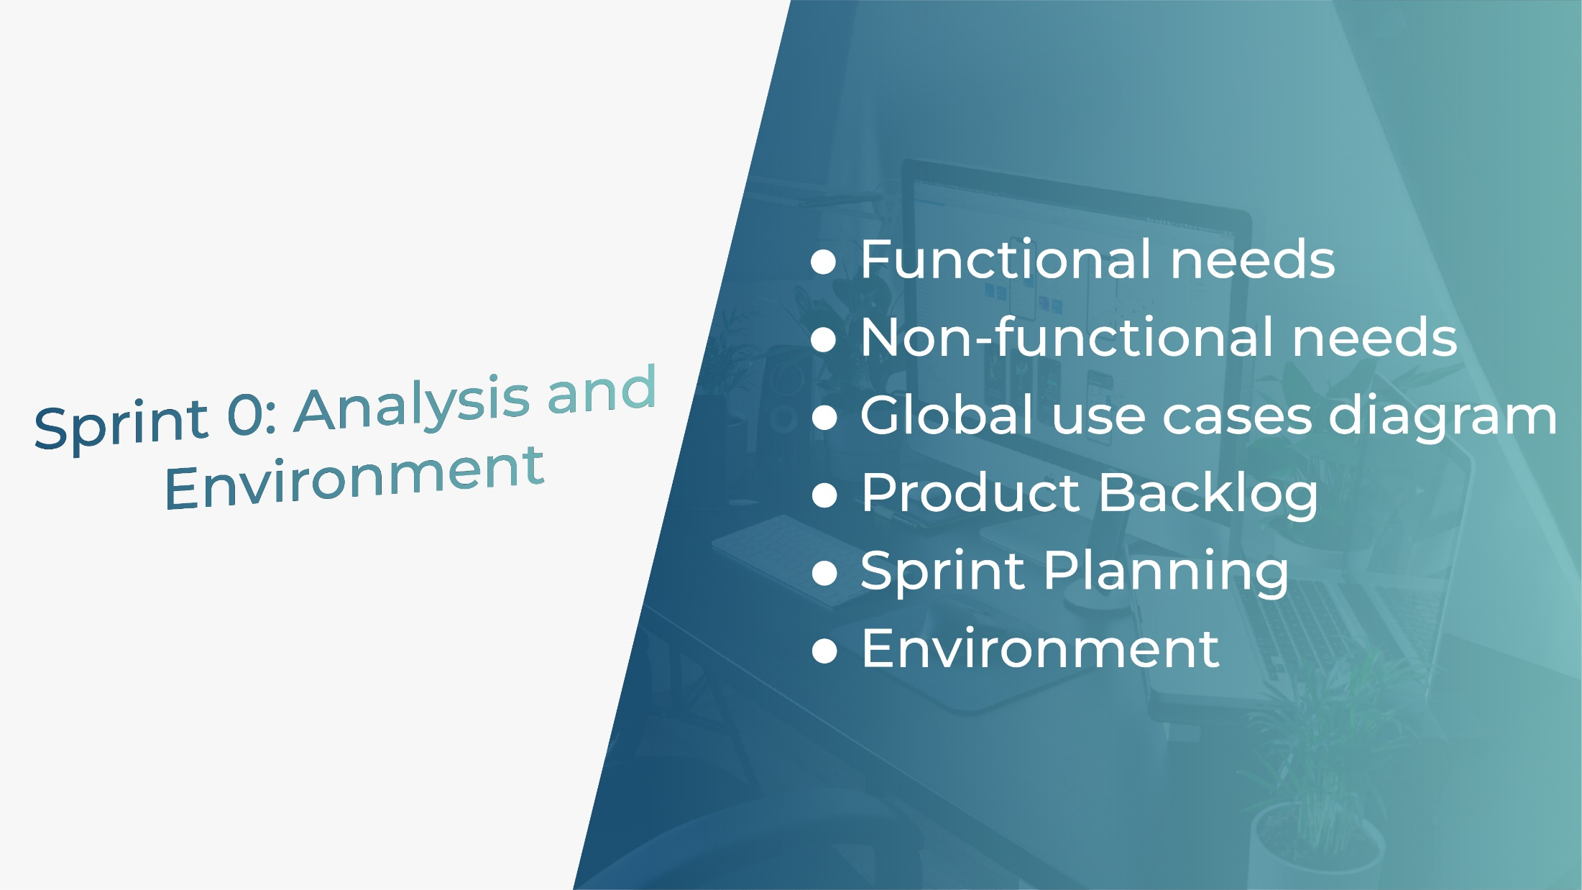

Slide 16




ACTORS IDENTIFICATION
Admin
Seller
Buyer
Guest

Slide 17



FUNCTIONAL NEEDS
User management
Delete a user
See registered user
See reported user
Seller Ads management
Check Ads
View a specific ad details
Add an ad to favorites list
See favorites ads list
Report ad
Share ad
Share seller profile
Report seller
Follow seller
Profile management
Check profile
Edit profile
See ads
See favorites ads
Admin
Seller
Ads management
Place a new ad
Edit ads
Delete ads
Accept or refuse ads
Delete seller ad
Admin
Buyer
Seller

Slide 18
NON-FUNCTIONAL NEEDS
–Usability: The website must present a clear and responsive interface and hierarchy of information to guarantee the understanding of the different processes
–Extensibility: The website should be able to integrate new features without any major changes to its basic architecture
–Reliabilty: The website must run correctly and without containing any bugs, and in case of disruption, the system should ensure its availability and recoverability

Slide 19
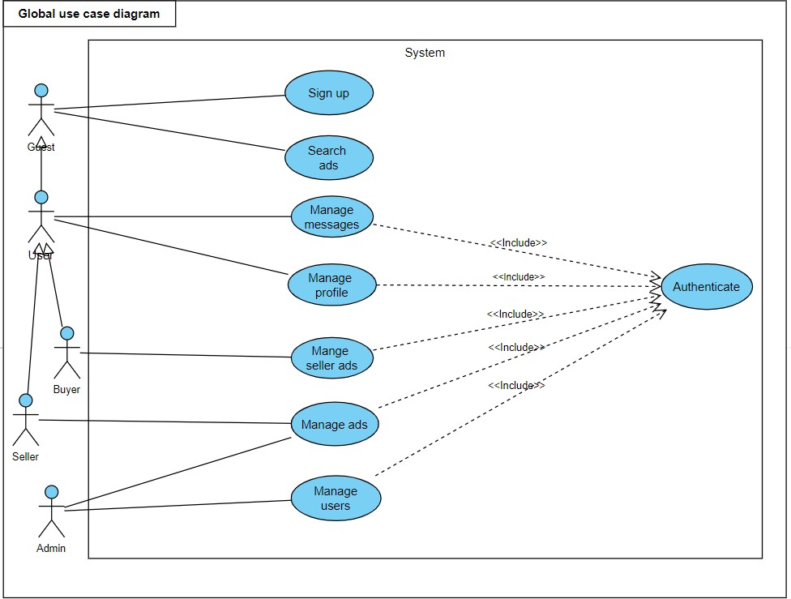
GLOBAL USE CASE DIAGRAM

Slide 20
PRODUCT BACKLOG
ID | Features | User Story | Priority
1 | Authentication | As an Admin, a Buyer, and a Seller: -I can login to website using phone number and password. -I can logout of the website | M
2 | Signup | As a Buyer a Seller and a Guest: - I can Sign up to the website | M
3 | Users Management | As an ADMIN: -I can see registered users. -I can delete a user. -I can see reported users | M
4 | Profile Management | As a Buyer and a Seller: -I can check profile -I can edit profile. | S

Slide 21
PRODUCT BACKLOG
5 | Consult Ads | As a Guest a Buyer and a Seller: -I can search for ads | S
6 | Ads management | As a Seller: -I can place a new ad. -I can edit ads -I can delete my ads -I can see views number of my ads. As an Admin: -I can accept or refuse ads -I can delete ads | S

Slide 22
PRODUCT BACKLOG
7 | Manage seller ads | As a Buyer: -I can check Ads I can edit a task -I can view a specific ad detail. -I can place an ad to my favorites list. -I can see favorites ads list -I can report ad. -I can share ad. -I can report seller -I can share seller profile | S

Slide 23

SPRINT PLANNING
07 April
07 May
Authentication
Profile Management
Users Management
-Seller Ads Management
Ads Management
#2
#1
#
Release2
Release1

Slide 24




ENVIRONMENT
React JS
Front-end library
MongoDB
NoSQL database
Express JS Flexible Node.js web application framework
NodeJS
JavaScript Runtime
Environment
MERN Stack

Slide 25
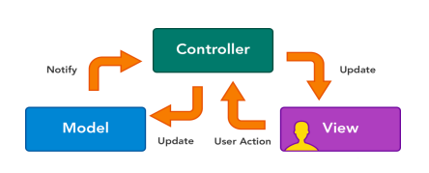
ARCHITECTURE

Slide 26
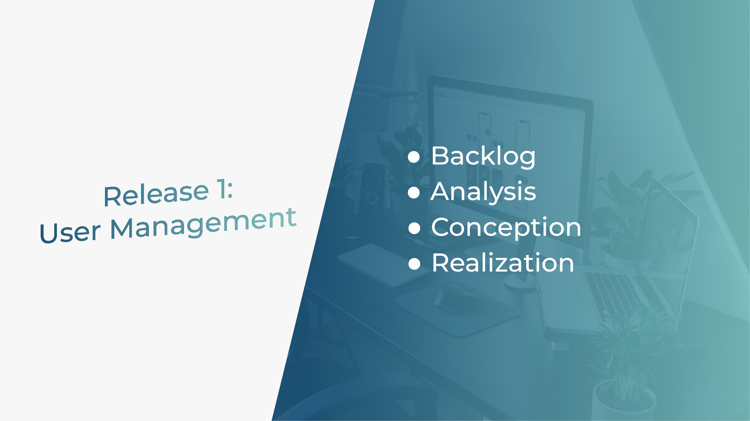
Notes:
We move to the release 1 entiteled user mangement wich contain

Slide 27
BACKLOG
ID | Features | User Story | Priority
1 | Authentication | As an Admin, a Buyer, and a Seller: -I can login to website using phone number and password. -I can logout of the website | M
2 | Signup | As a Buyer a Seller and a Guest: - I can Sign up to the website | M
3 | Users Management | As an Admin: -I can see registered users. -I can delete a user. -I can see reported users | M
4 | Profile Management | As a Buyer and a Seller: -I can check profile -I can edit profile. | S
Notes:
The first sprint backlog envolves as features

Slide 28
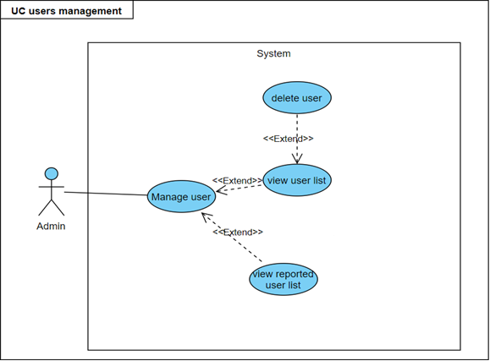
ANALYSIS
Refinement of "User Management" use case
Notes:
Here is the refinement of

Slide 29
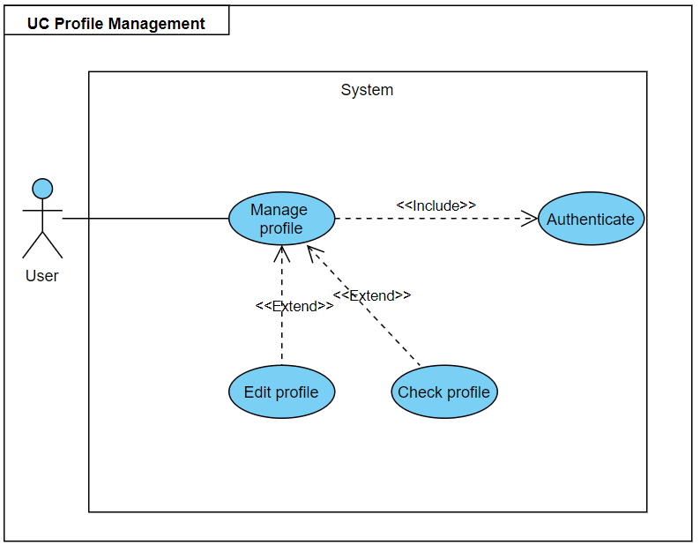
ANALYSIS
Refinement of "Profile management" use case

Slide 30
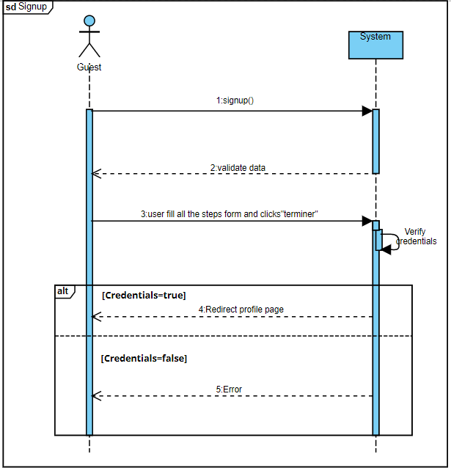
ANALYSIS
Sequence Diagram: Sign up

Slide 31
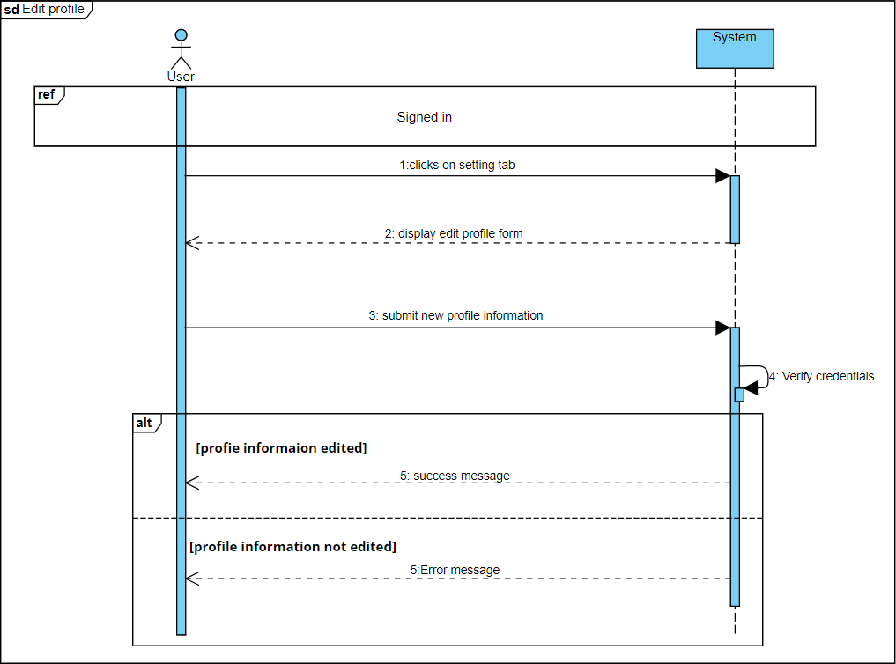
ANALYSIS
Sequence Diagram: Edit profile

Slide 32
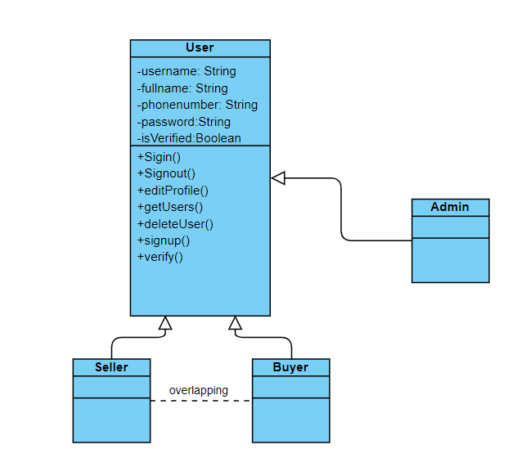
CONCEPTION
Notes:
Passing to the conception part we have the class diagram of the first sprint which contain four classes

Slide 33
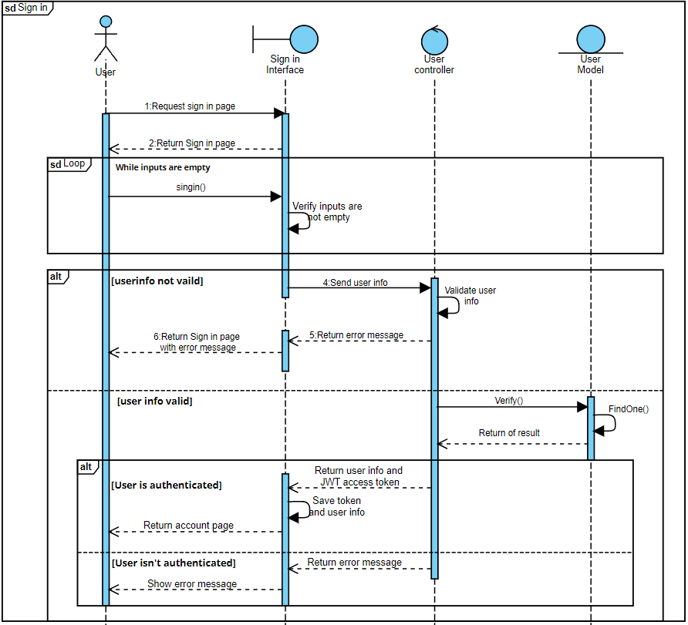
CONCEPTION
Interactive Diagram for Sign In

Slide 34
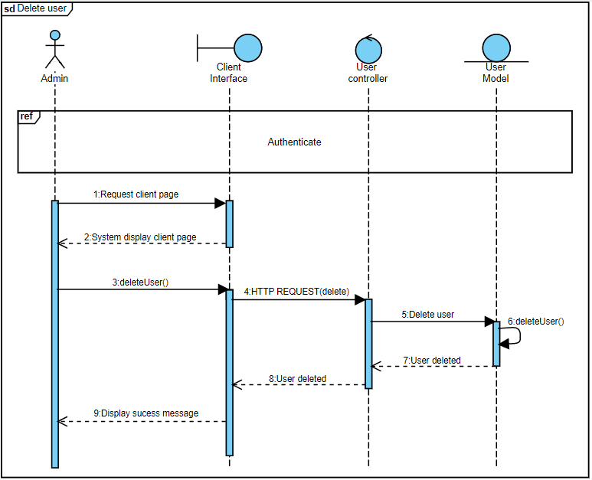
CONCEPTION
Interactive Diagram for Delete User

Slide 35
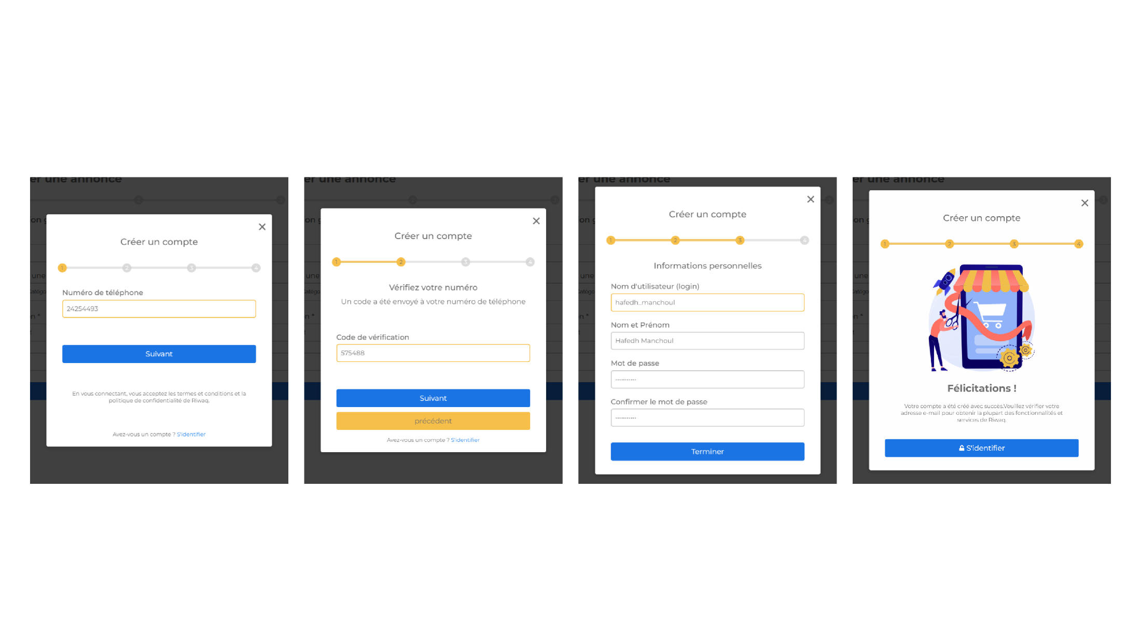
Sign-up
REALIZATION
Notes:
And those are some interfaces of the project for example sign-up

Slide 36
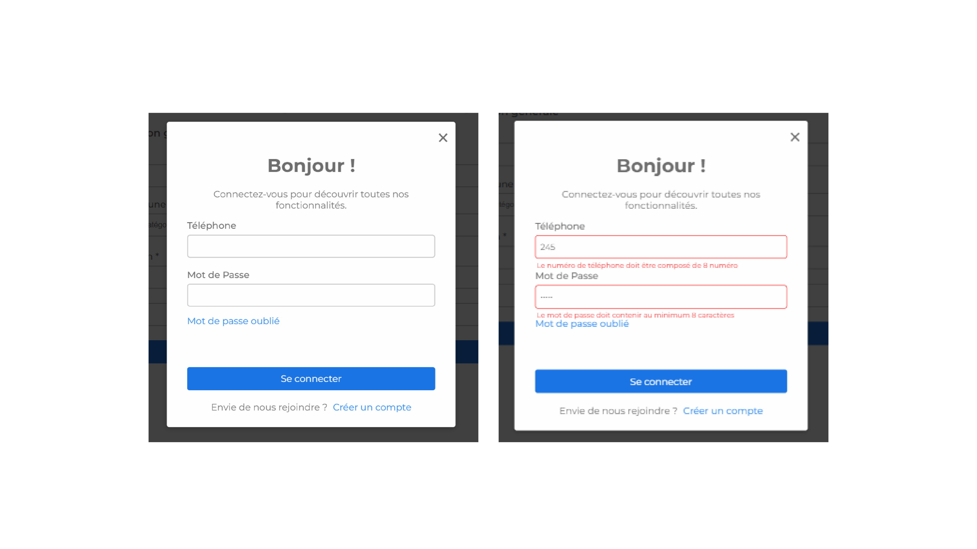
Authentification
REALIZATION

Slide 37
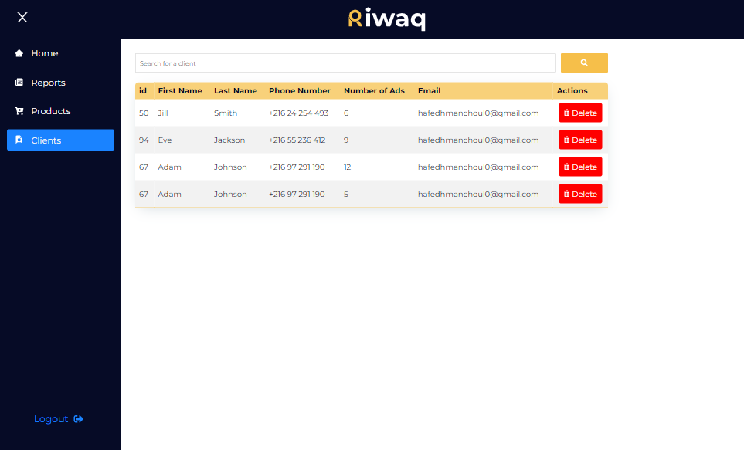
Users Management
REALIZATION

Slide 38
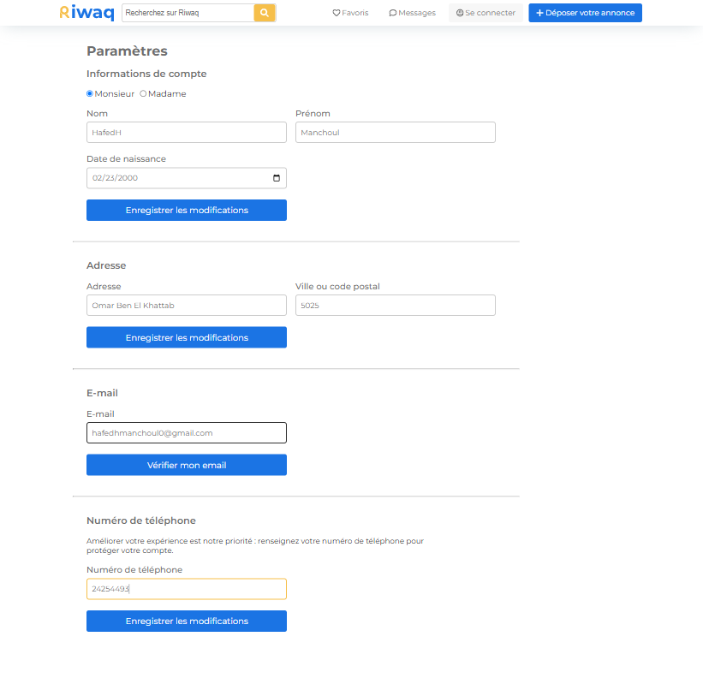
Profile Management
REALIZATION

Slide 39
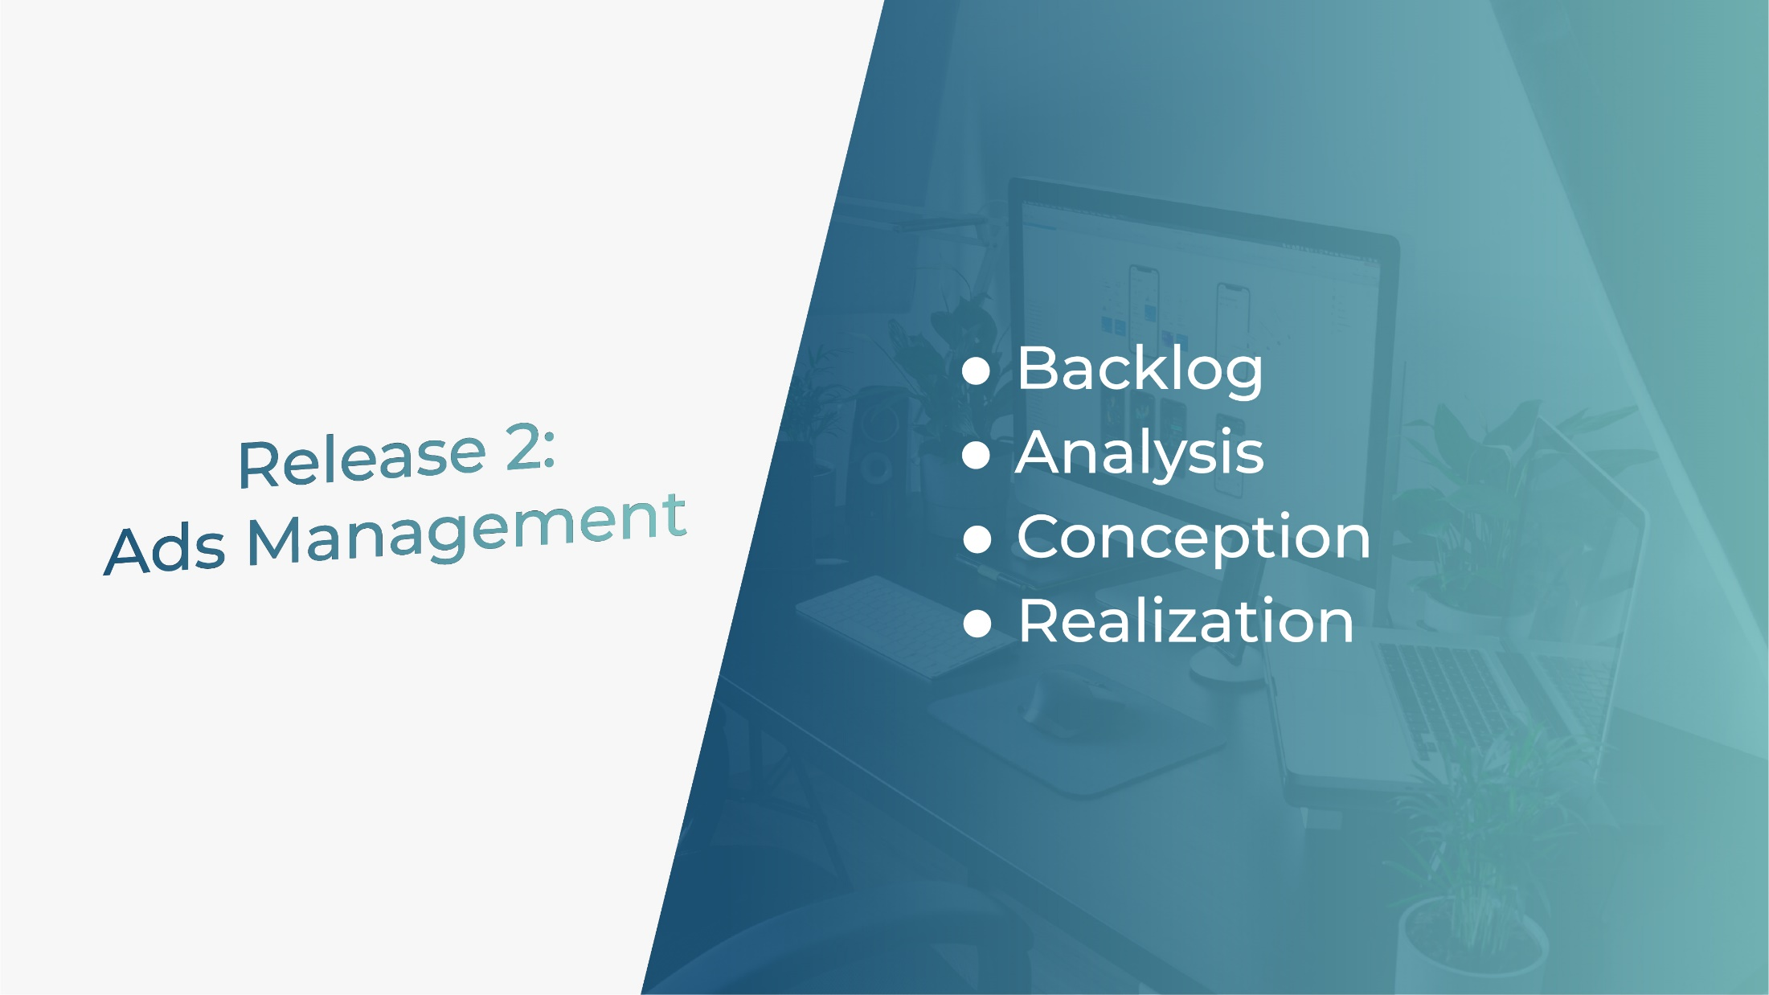

Slide 40
BACKLOG
5 | Consult Ads | As a Guest a Buyer and a Seller: -I can search for ads | S
6 | Ads management | As a Seller: -I can place a new ad. -I can edit ads -I can delete my ads As an Admin: -I can accept or refuse ads -I can delete ads | S

Slide 41
BACKLOG
7 | Manage seller ads | As a Buyer: -I can check Ads I can edit a task -I can view a specific ad detail. -I can place an ad to my favorites list. -I can see favorites ads list -I can report ad. -I can share ad. -I can report seller -I can share seller profile | S

Slide 42
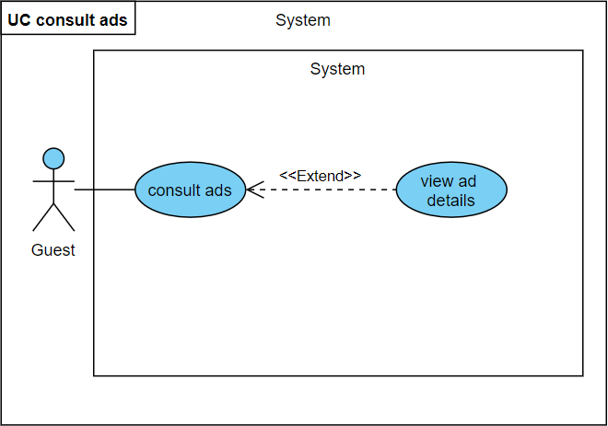
ANALYSIS
Refinement of "Consult Ads" use case

Slide 43
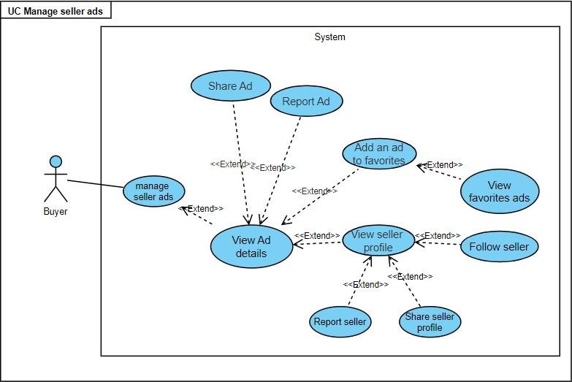
ANALYSIS
Refinement of "Seller Ads Management" use case

Slide 44
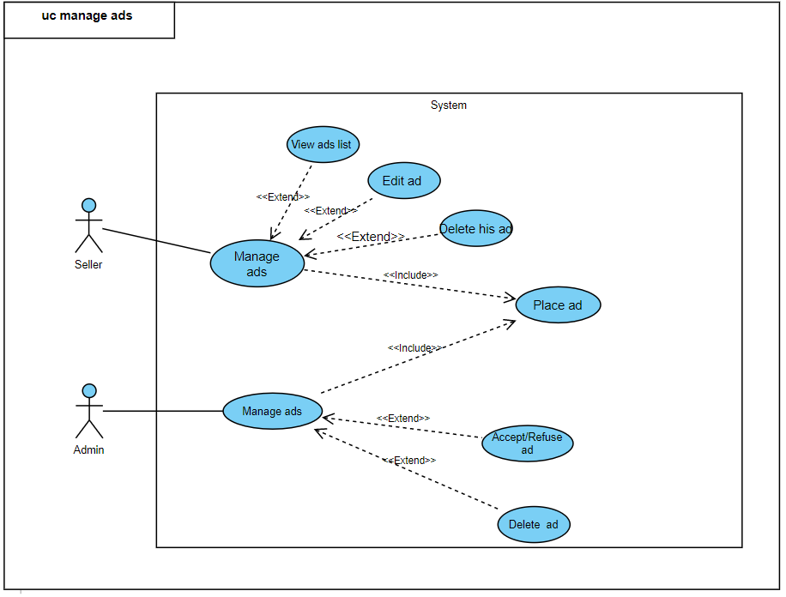
ANALYSIS
Refinement of " Ads Management" use case

Slide 45
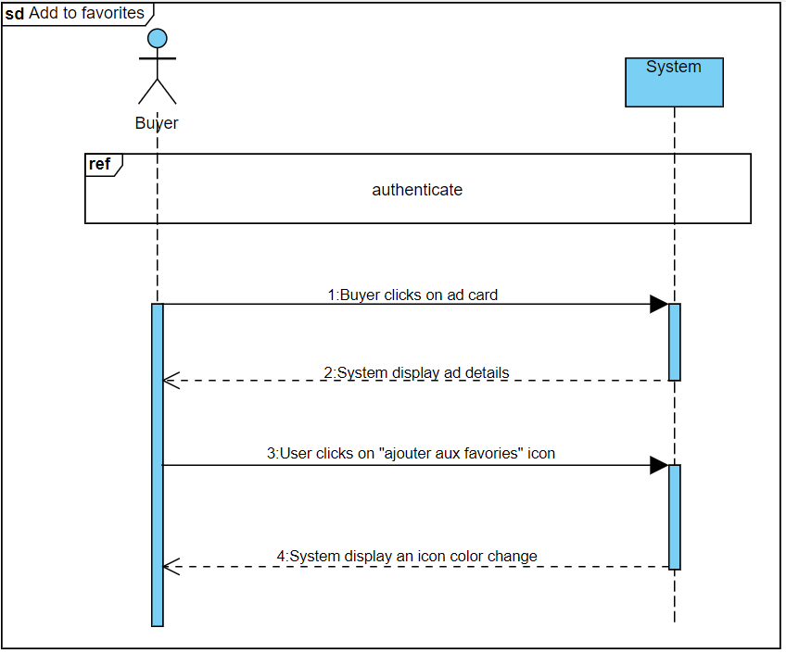
ANALYSIS
Sequence Diagram: Add and ad to favorites

Slide 46
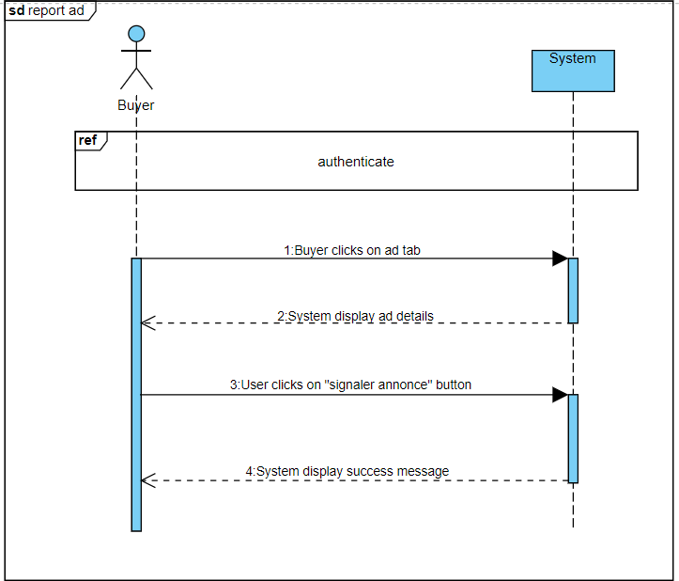
ANALYSIS
Sequence Diagram: Report ad

Slide 47
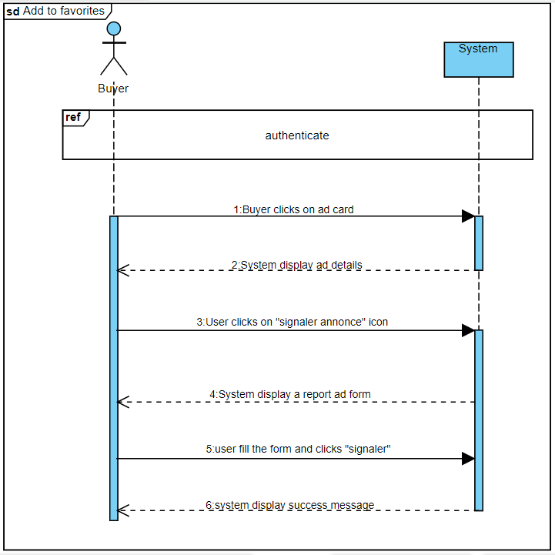
ANALYSIS
Sequence Diagram: Place ad

Slide 48
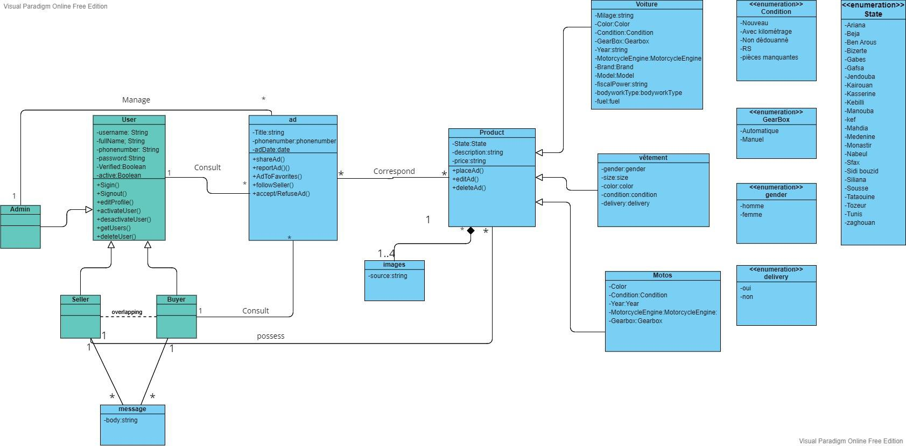
CONCEPTION
v

Slide 49
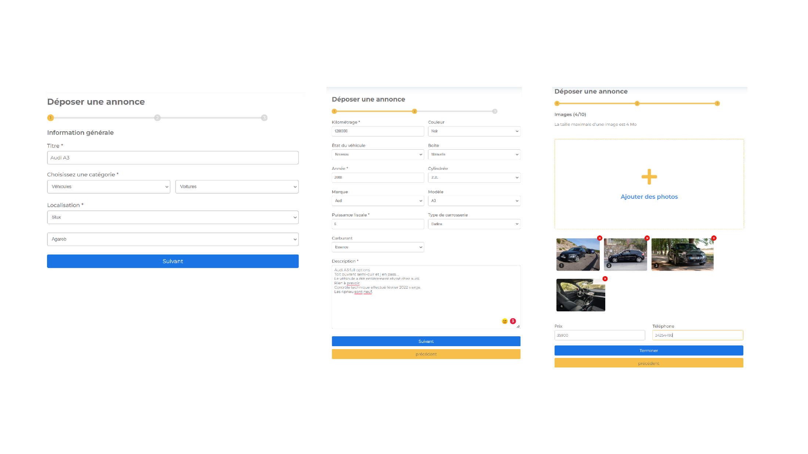
Place ad
REALIZATION
Step1
Step2
Step3

Slide 50
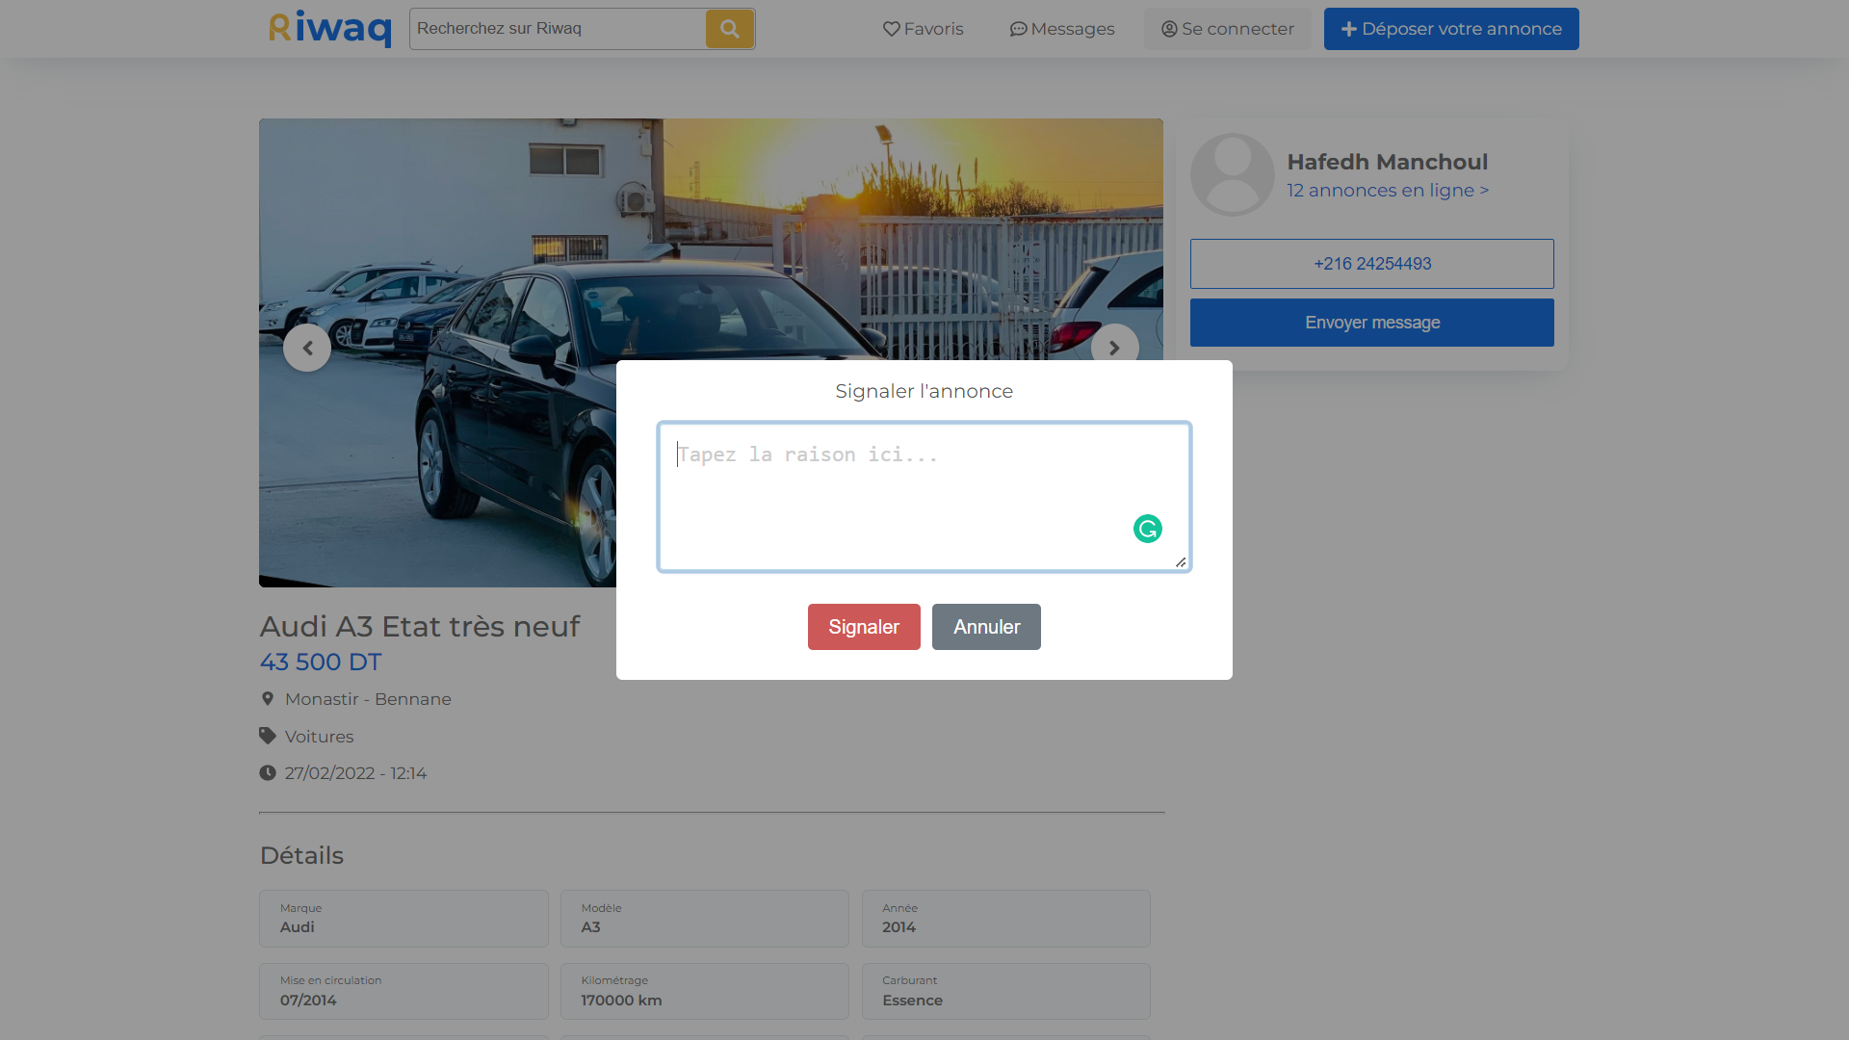
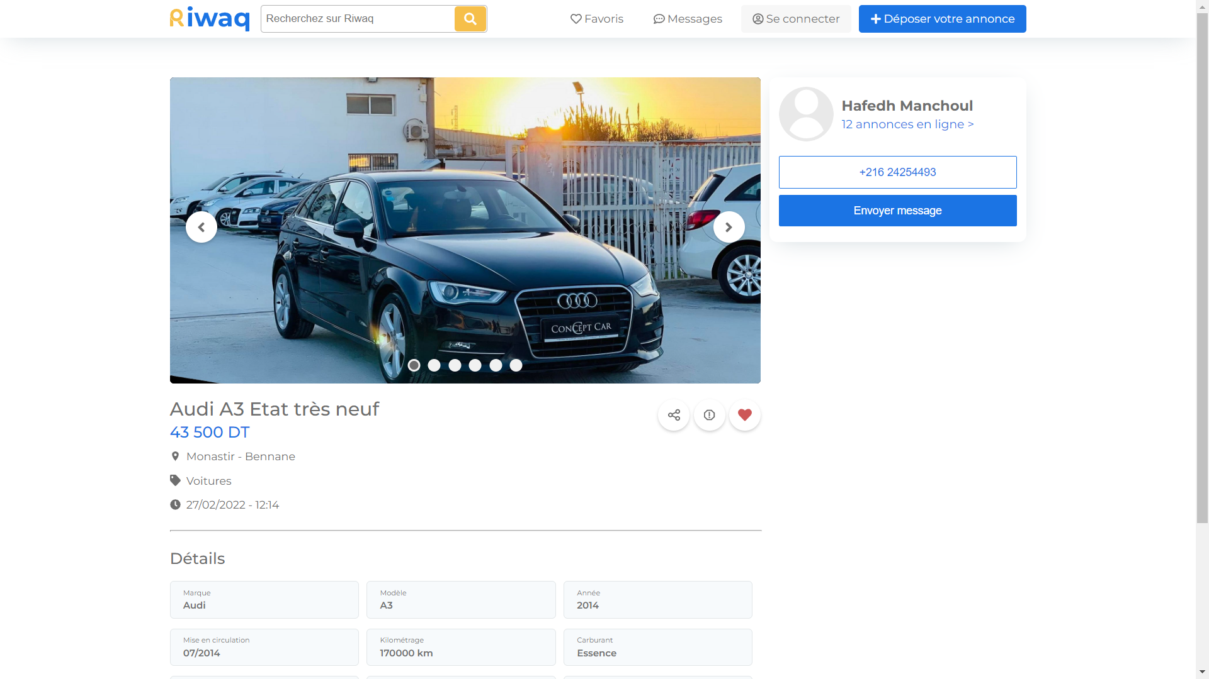
Report ad
REALIZATION

Slide 51
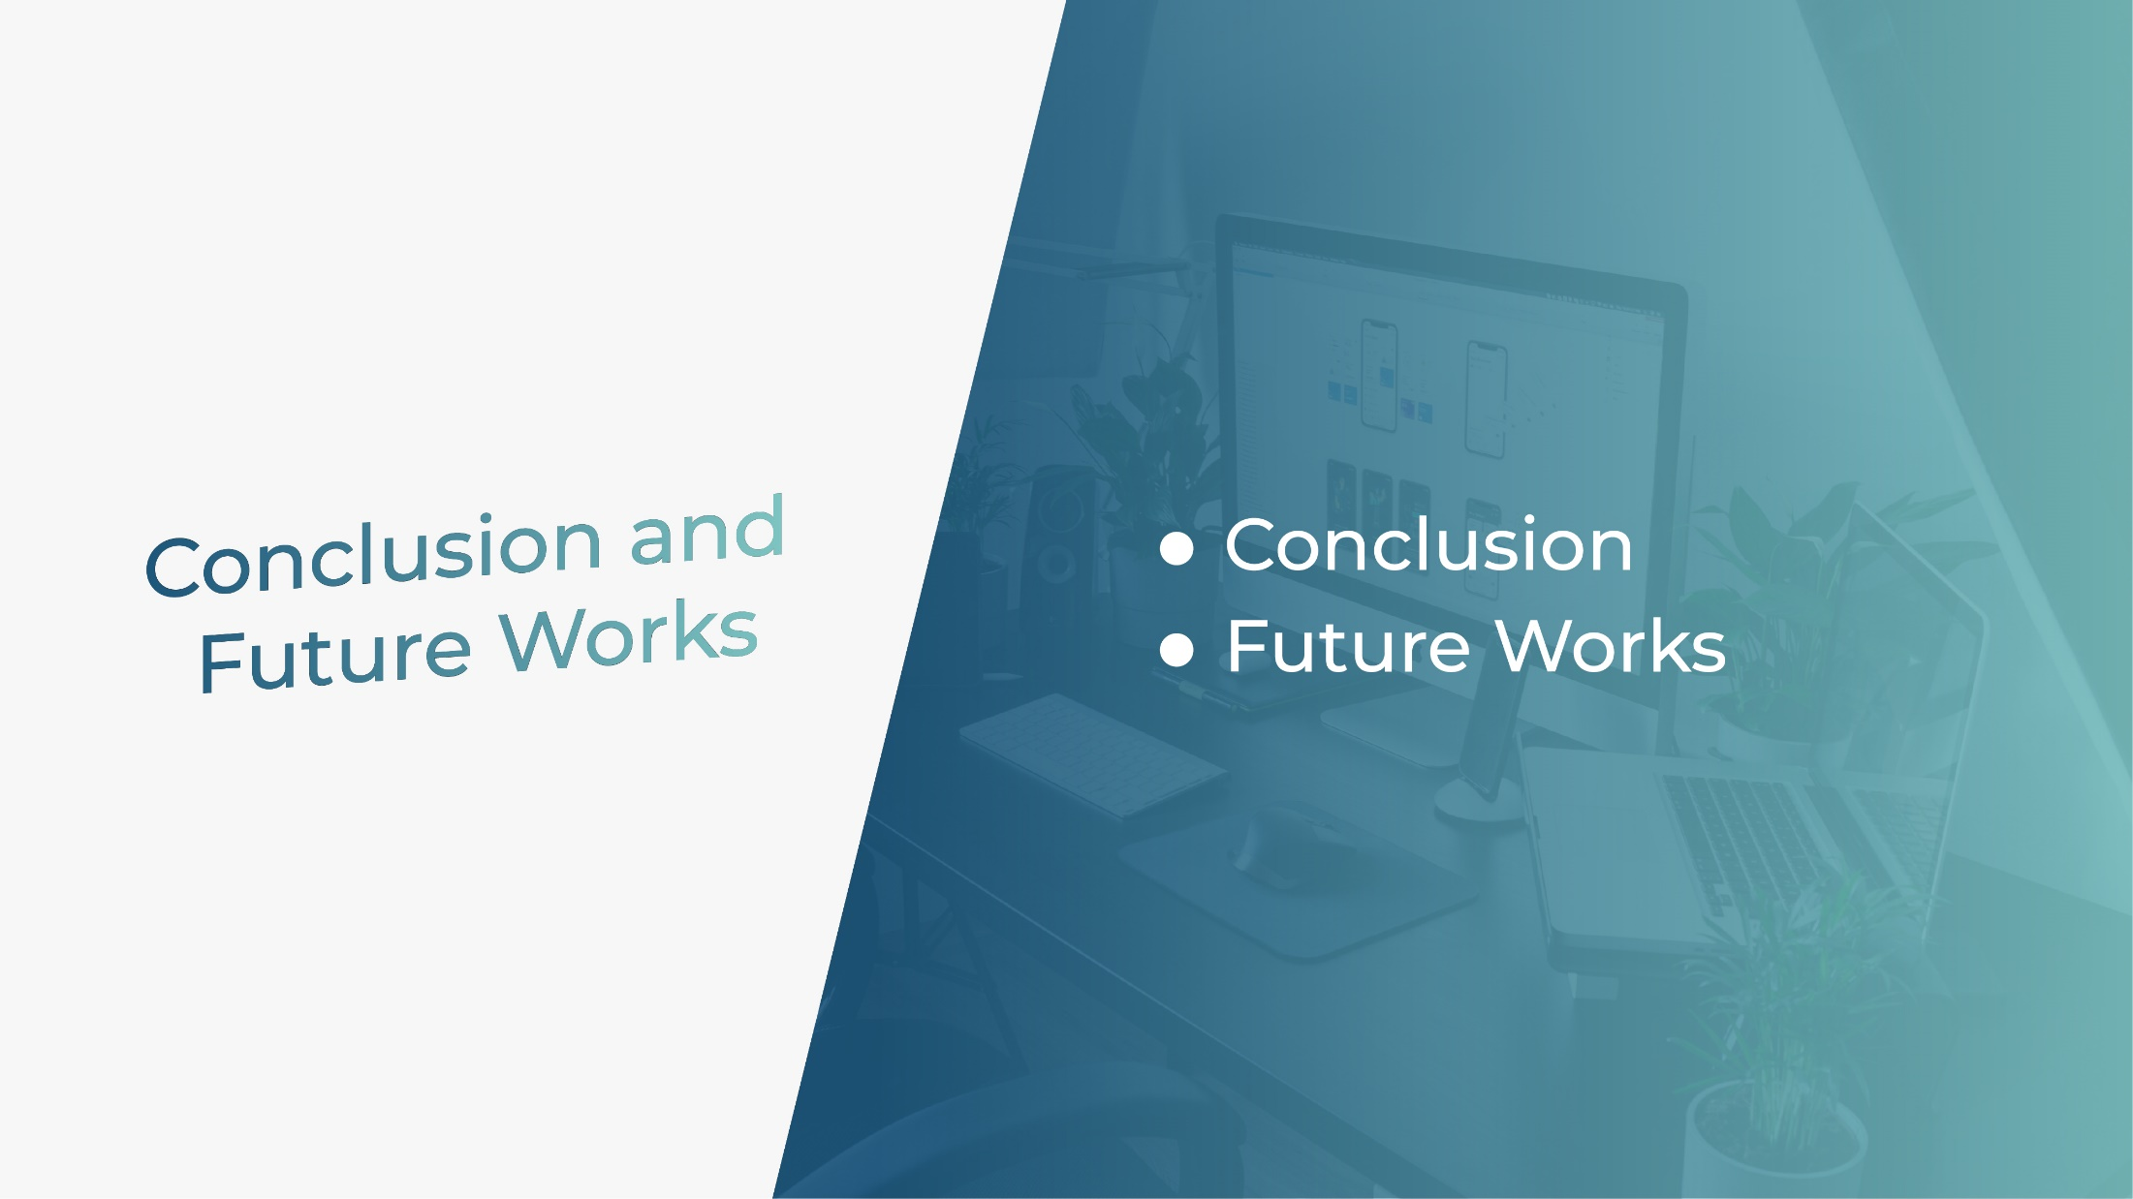

Slide 52
CONCLUSION
Improve transactions between sellers and buyers
Digitalize buying and selling process
Gathering all the used products in the same place

Slide 53
FUTURE WORKS
Integrating product recommendation based on Ai
Add video call communication
Developing a Mobile Application

Slide 54


